Slide 1

Auto Insurance Claims Analysis and Prediction
By: Rebecca Leu

Slide 2
The dataset:
Sourced from Kaggle
40 variables and 1000 observations
Each row is a claim, each column is a variable from that claim or policyholder
Examples:
Incident date
Damage severity
Collision type
Number of vehicles involved
Authorities contacted

Slide 3
The business question
“Using information gathered in the first notice of the accident to the insurance companies, can we predict what the total claim value will be?”

Slide 4
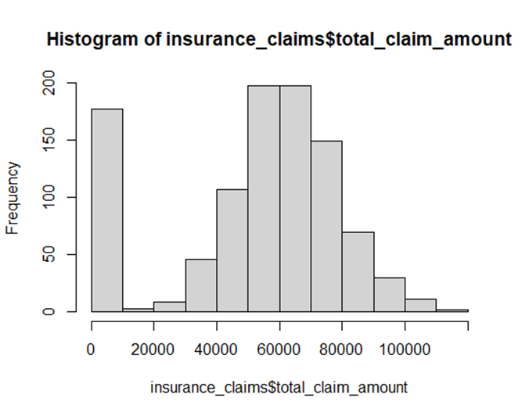
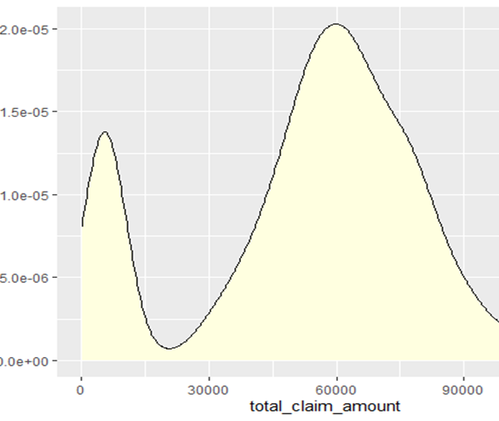
Exploratory Data Analysis
These graphs show us the distribution of our predictor variable – total claim amount

Slide 5
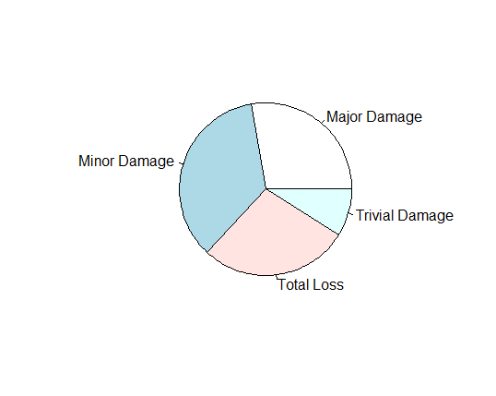
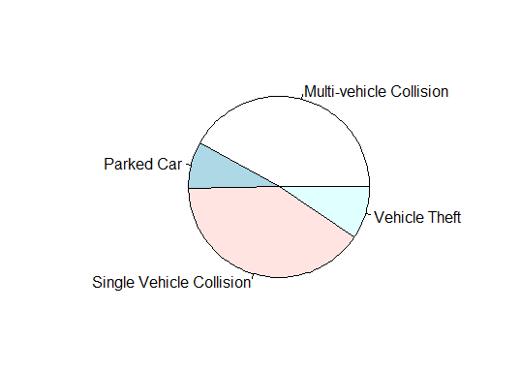
Proportion of Claim types

Slide 6
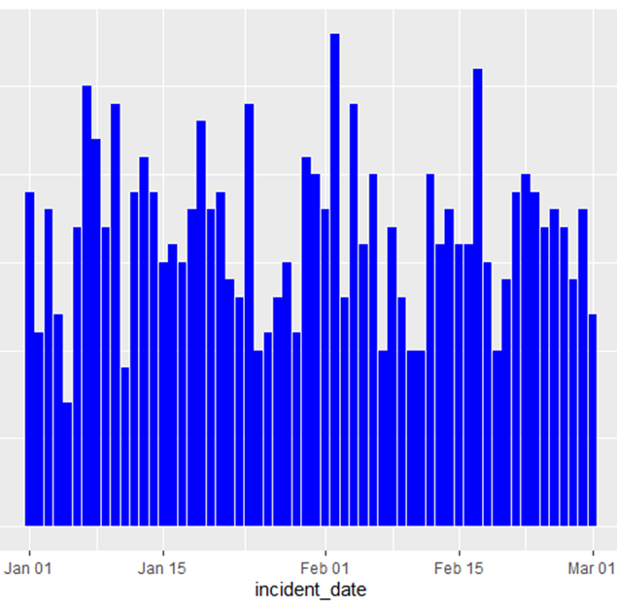
Time range of claim reporting

Slide 7
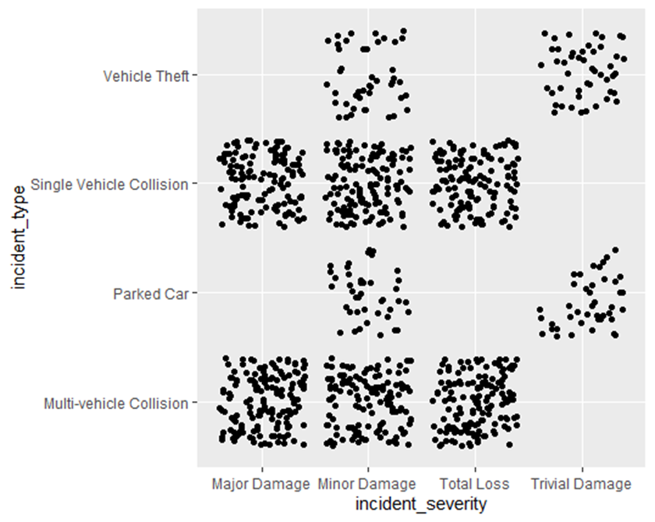
Connections between incident type and severity

Slide 8
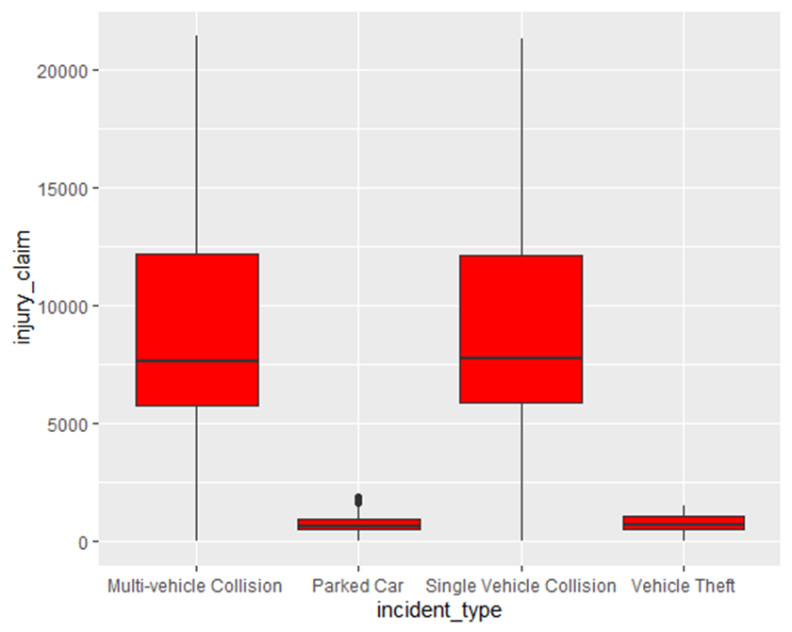
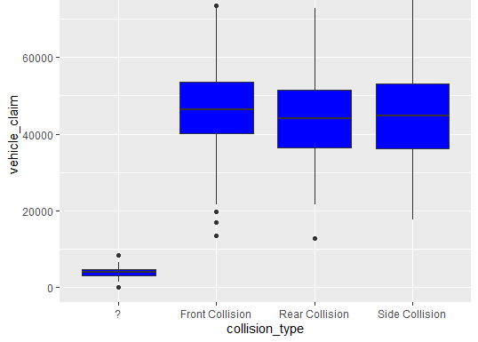
Boxplots showing injury claim amounts and vehicle claim amounts by collision types

Slide 9
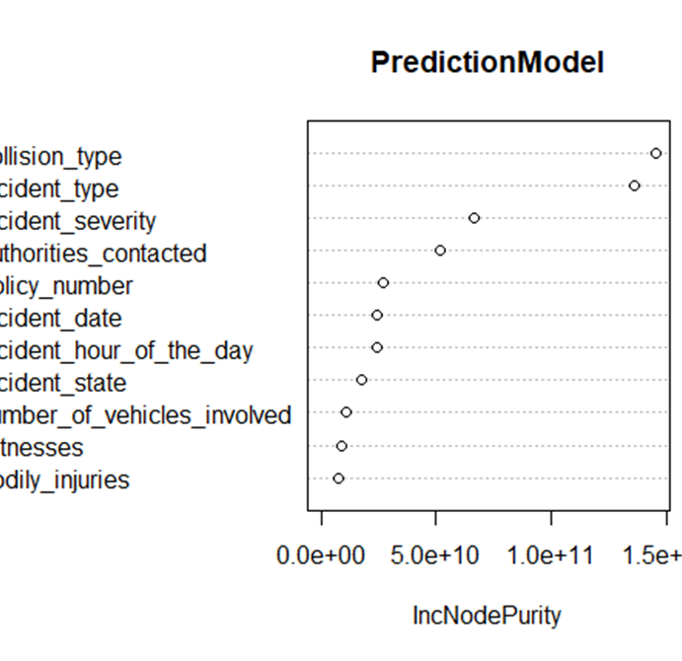
The results
Most important factors:
Collison type
Incident type
Incident severity
Authorities contacted

Slide 10
References
Arpan Gupta (Indian Institute of Technology, R. (n.d.). Random Forest in R. Retrieved December 04, 2020, from http://analyticsdataexploration.com/random-forest-for-data-analytics-in-r/
Data Wrangling with dplyr and tidyr Cheat Sheet. (n.d.). Retrieved from https://rstudio.com/wp-content/uploads/2015/02/data-wrangling-cheatsheet.pdf
Kabacoff, R. (2015). R in action: Data analysis and graphics with R. Shelter Island, NY: Manning.
Misraaakash1998Check out this Author's contributed articles., Misraaakash1998, & Check out this Author's contributed articles. (2020, July 22). Root-Mean-Square Error in R Programming. Retrieved December 04, 2020, from https://www.geeksforgeeks.org/root-mean-square-error-in-r-programming/
Tutorial: Building train and test sets with the same characteristics. (2020, November 13). Retrieved December 04, 2020, from https://cran.r-project.org/web/packages/dataPreparation/vignettes/train_test_prep.html

